Slide 1

Web/iOS Development
Shyne
2014.10.15

Slide 2

Today
Apple developer account
Spend 10 mins discuss “the pitch”
Questions?
Continue on OOP
  Inheritance
  Misc
Objective C
  Class inheritance
  Properties
  Create an object
  Accessors

Slide 3
Today
一般Android在設計會以解析度為準hdpi, xhdpi, xxhdpi
所以我們在標示上通常以px或是dp為準
perenctage除非在要分割畫面為二或三或四，也就是等比例才會標示
因為android對multi-screen的solution是靠解析度調整，並非percentage
所以對percentage的支援度不高，而且overhead會很大
所以面對5", 7", 10.1"手機，一般有需要會出三種標示圖，我也要對應到不同layout
主流的device是xhdpi搭配720*1280
可以用這個解析度先出一個標示，之後對其他尺寸再調整

Slide 4
[OOP - inheritance]

Slide 5
Inheritance
In object-oriented programming (OOP), inheritance is when an object or class is based on another object or class, using the same implementation (inheriting from a class) or specifying implementation to maintain the same behavior (realizing an interface; inheriting behavior).
It is a mechanism for code reuse and to allow independent extensions of the original software via public classes and interfaces. The relationships of objects or classes through inheritance give rise to a hierarchy.

Slide 6
Inheritance
In object-oriented programming (OOP), inheritance is when an object or class is based on another object or class, using the same implementation (inheriting from a class) or specifying implementation to maintain the same behavior (realizing an interface; inheriting behavior).
It is a mechanism for code reuse and to allow independent extensions of the original software via public classes and interfaces. The relationships of objects or classes through inheritance give rise to a hierarchy.

Slide 7
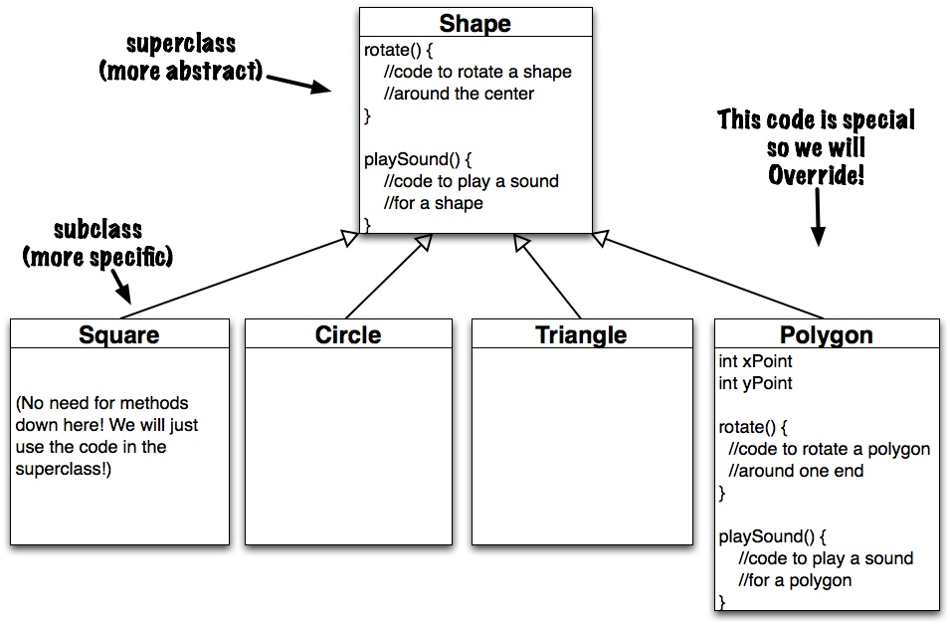
Inheritance

Slide 8
Exercise - inheritance
Exercise – come up with an example

Slide 9
[OOP - misc]

Slide 10
OOP - more
Constructors
  Initialize an object
Access control
  public: The member (data or function) is accessible and available to all in the system.
  private: The member (data or function) is accessible and available within this class only.
Information Hiding and Encapsulation
  Private first (put everything in .m, not .h)
  Do not make any data member public, unless you have a good reason.
Getters and Setters
Constructor/destructor
  Destroy an object

Slide 11
[Objective C - classes]

Slide 12

Classes inherit from other classes
When one class inherits from another, the child inherits all the behavior and properties defined by the parent. It also has the opportunity either to define its own additional behavior and properties, or override the behavior of the parent.
In the case of Objective-C string classes, the class description for NSMutableString specifies that the class inherits from NSString
All of the functionality provided by NSString is available in NSMutableString, such as querying specific characters or requesting new uppercase strings, but NSMutableString adds methods that allow you to append, insert, replace or delete substrings and individual characters.

Slide 13

The root class - NSObject
Objective-C defines a root class from which the vast majority of other classes inherit, called NSObject. When one object encounters another object, it expects to be able to interact using at least the basic behavior defined by the NSObject class description.
When you’re defining your own classes, you should at a minimum inherit from NSObject. In general, you should find a Cocoa or Cocoa Touch object that offers the closest functionality to what you need and inherit from that.
If you want to define a custom button for use in an iOS app, for example, and the provided UIButton class doesn’t offer enough customizable attributes to satisfy your needs, it makes more sense to create a new class inheriting from UIButton than from NSObject.

Slide 14
Class interface
Interface is all you need to know in order to use a class is how to interact with its instances. More specifically, an object should be designed to hide the details of its internal implementation.
When you’re defining your own class, you need to start by figuring out these public attributes and behaviors.
  What attributes do you want to be accessible publicly?
  Should you allow those attributes to be changed?
  How do other objects communicate with instances of your class?
Rule – declare everything as private (in .m) first!

Slide 15
[Objective C - properties]

Slide 16
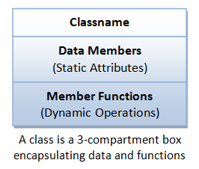
Properties
@interface Person : NSObject
@property NSString *firstName;
@property NSString *lastName;
@end
Both these properties are for Objective-C objects, so they use an * to indicate that they are C pointers
They are also statements just like any other variable declaration in C, and therefore require a semi-colon at the end.

Slide 17
Properties
@interface Person : NSObject
@property NSString *firstName;
@property NSString *lastName;
@property NSNumber *yearOfBirth;
or
@property int yearOfBirth;
@end

Slide 18
Property attributes
atomic nonatomic
strong weak
readwrite readonly
getter= setter=
copy assign
retain unsafe_unretained
Rule – use default for now
http://ios-blog.co.uk/tutorials/objective-c-property-attribute-reference-guide/

Slide 19
[Objective C - accessors]

Slide 20
Accessors – getter and setter
By default, these accessor methods are synthesized automatically for you by the compiler, so you don’t need to do anything other than declare the property using @property in the class interface.
The synthesized methods follow specific naming conventions:
  The method used to access the value (the getter method) has the same name as the property.
  The getter method for a property called firstName will also be called firstName.
  The method used to set the value (the setter method) starts with the word “set” and then uses the capitalized property name.
  The setter method for a property called firstName will be called setFirstName

Slide 21
Getter and setter example
Using methods
NSString *firstName = [somePerson firstName];
[somePerson setFirstName:@"Johnny"];
Using dot notation
NSString *firstName = somePerson.firstName;
somePerson.firstName = @"Johnny";

Slide 22
Implement custom accessor methods
Getter example
  - (NSString *)fullName {
  return [NSString stringWithFormat:@"%@ %@", self.firstName, self.lastName];
  }
  - (XYZObject *)someImportantObject {
  if (!_someImportantObject) {
  _someImportantObject = [[XYZObject alloc] init];
  }
  return _someImportantObject;
  }

Slide 23
Implement custom accessor methods
Setter example
-(void)setFirstName:(NSString *) firstName {
  _firstName = firstName;
  }

Slide 24
[Create an object]

Slide 25
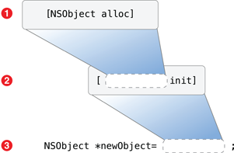
Create an instance(object)
Objects are created dynamically
  NSObject *newObject = [[NSObject alloc] init]; or
  NSObject *newObject = [NSObject new];

Slide 26
Create objects with arguments
Example: NSNumber class
  - (id)initWithBool:(BOOL)value;
  - (id)initWithFloat:(float)value;
  - (id)initWithInt:(int)value;
  - (id)initWithLong:(long)value;
  NSNumber *magicNumber = [[NSNumber alloc] initWithInt:42];
Exercise : XYZPerson with first name and last name
  -(id)initWithFirstName:(NSString *) firstName andLastName:(NSString *) lastName;

Slide 27
Self and super
Self is a way to refer to “the object that’s received this message.” It’s a pointer and can be used to call a method on the current receiving object.
Sending a message to super is a way to call through to a method implementation defined by a superclass further up the inheritance chain. The most common use of super is when overriding a method.
self means the calling object at runtime, while super means the superclass of the class where the method definition is.
In both cases they are specifying where the search for a method should start, in the case of self the starting point is determined dynamically, in the super case it is known at compile time.

Slide 28
Objective-C classes are also objects
In Objective-C, a class is itself an object with an opaque type called Class. Classes can’t have properties defined using the declaration syntax shown earlier for instances, but they can receive messages.
The typical use for a class method is as a factory method, which is an alternative to the object allocation and initialization
Example: NSNumber
  + (NSNumber *)numberWithBool:(BOOL)value;
  + (NSNumber *)numberWithFloat:(float)value;
  + (NSNumber *)numberWithInt:(int)value;
  + (NSNumber *)numberWithLong:(long)value;
  NSNumber *magicNumber = [NSNumber numberWithInt:42];

Slide 29
Exercise – bank system
Classes
  Person
  |------------ clerk
  |------------ customer
  Branch

Slide 30
Create the following classes in Obj-C
Classes
  NSObject
    |----XYZPerson
    |------------ clerk
    |------------ customer
    l----Branch
Open an account
IBActions

Slide 31
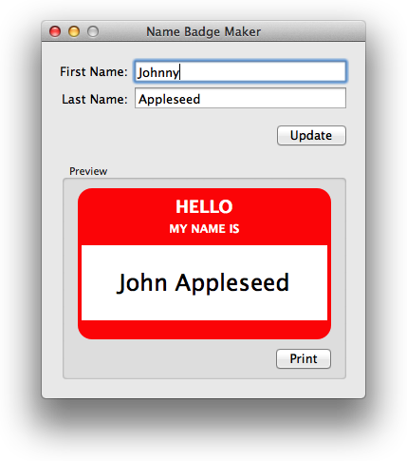
Homework
Please implement the following UI (if you don’t want to use your storyboard)
NOTE: 90 second demo

Slide 32
~ END ~
http://www.alphacamp.tw

